Slide 1
Machine Learning for ion recognition and trapping
Build a Neural Network which can detect an ion in a CCD image
Can be used to automate trapping procedure
Possible to detect dim or obscured ions with noisy backgrounds
May prove useful with CMOS, lower spec. cameras

Slide 2
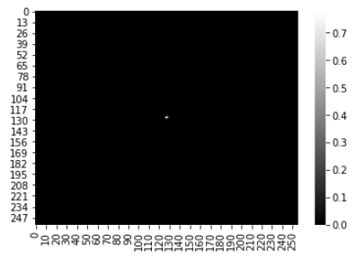
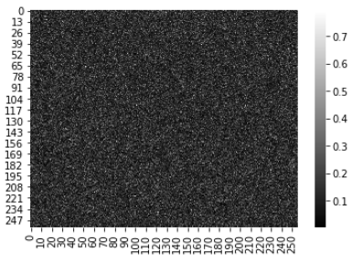
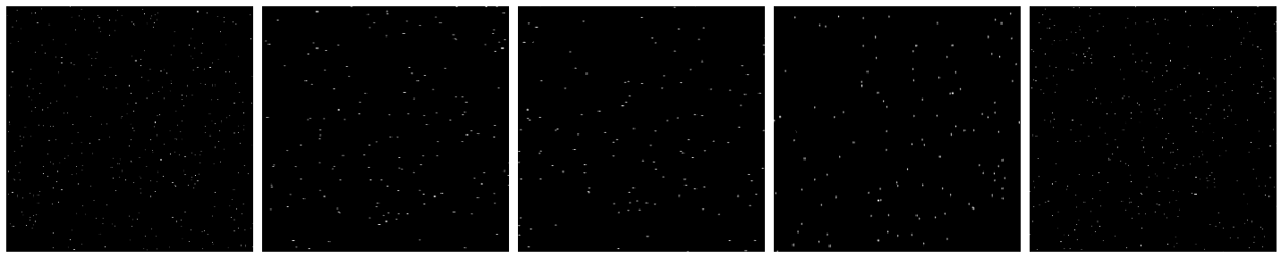
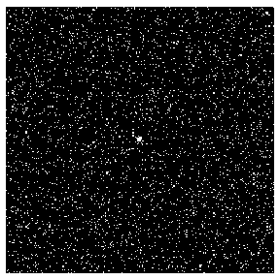
Training Data
Proof of principle with simulated data
Difficult to get a large set of training images from a real camera or experimental setup at the moment.
Model could be retrained on real camera image data at a later stage if successful
Created a dataset of artificial ions using a 2-d gaussian function
Simulated background noise by experimenting with different noise functions.
2000 images: 1000 with ion, 1000 without ion

Slide 3

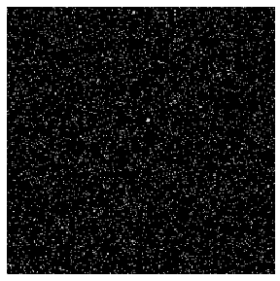
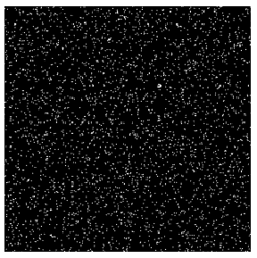
Generating variation in the training images
Require model to be robust against:
Ion position
Variation in background noise
Changes in ion brightness/obscurity
Augment data to include:
Rotations
Translations
Scaling
Ion
No Ion

Slide 4
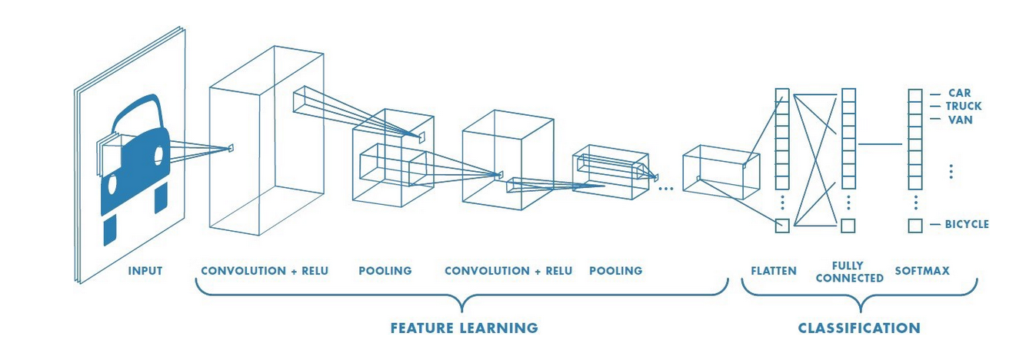
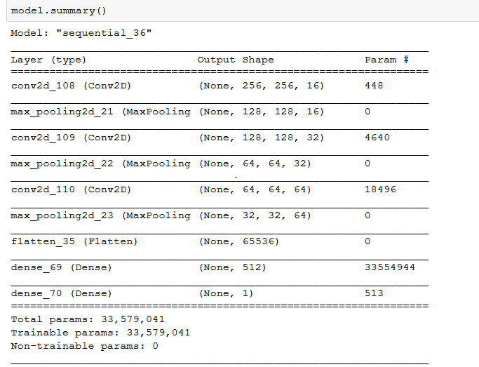
The Model
Convolutional Neural Network (CNN)
Typical choice for image classification tasks
Extract dominant features of an image via series of convolution and pooling layers
Reduced dimensionality data then passed fully connected layers to extract non-linearly combinations of features

Slide 5
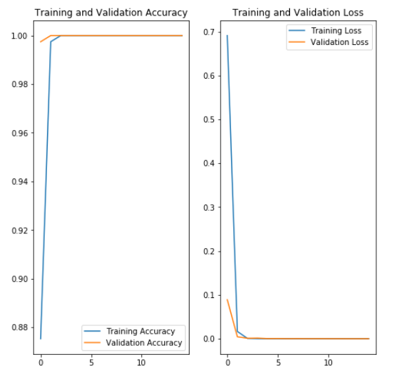
Performance
Model performs excellently in spite of ion position, brightness, size and noise variations
Model is likely to be somewhat overfit as the validation data, while having randomly generated variations, is created similarly to training data set
Could remedy overfitting by introducing more variation in the data
Further improvements:
Test current model using real image data from an experiment
Train/validate on real image data by collecting a data from an experiment camera
Incorporate trained Neural Network as backend in experiment control for real-time ion detection and trapping automation.

